Slide 1



Slide 2

Cim 474 – Under Boiler Filter
Availablle in two version: Grey and White

Slide 3
TYPICAL INSTALLATION
Filter for
compact
installation
under
the boiler

Slide 4
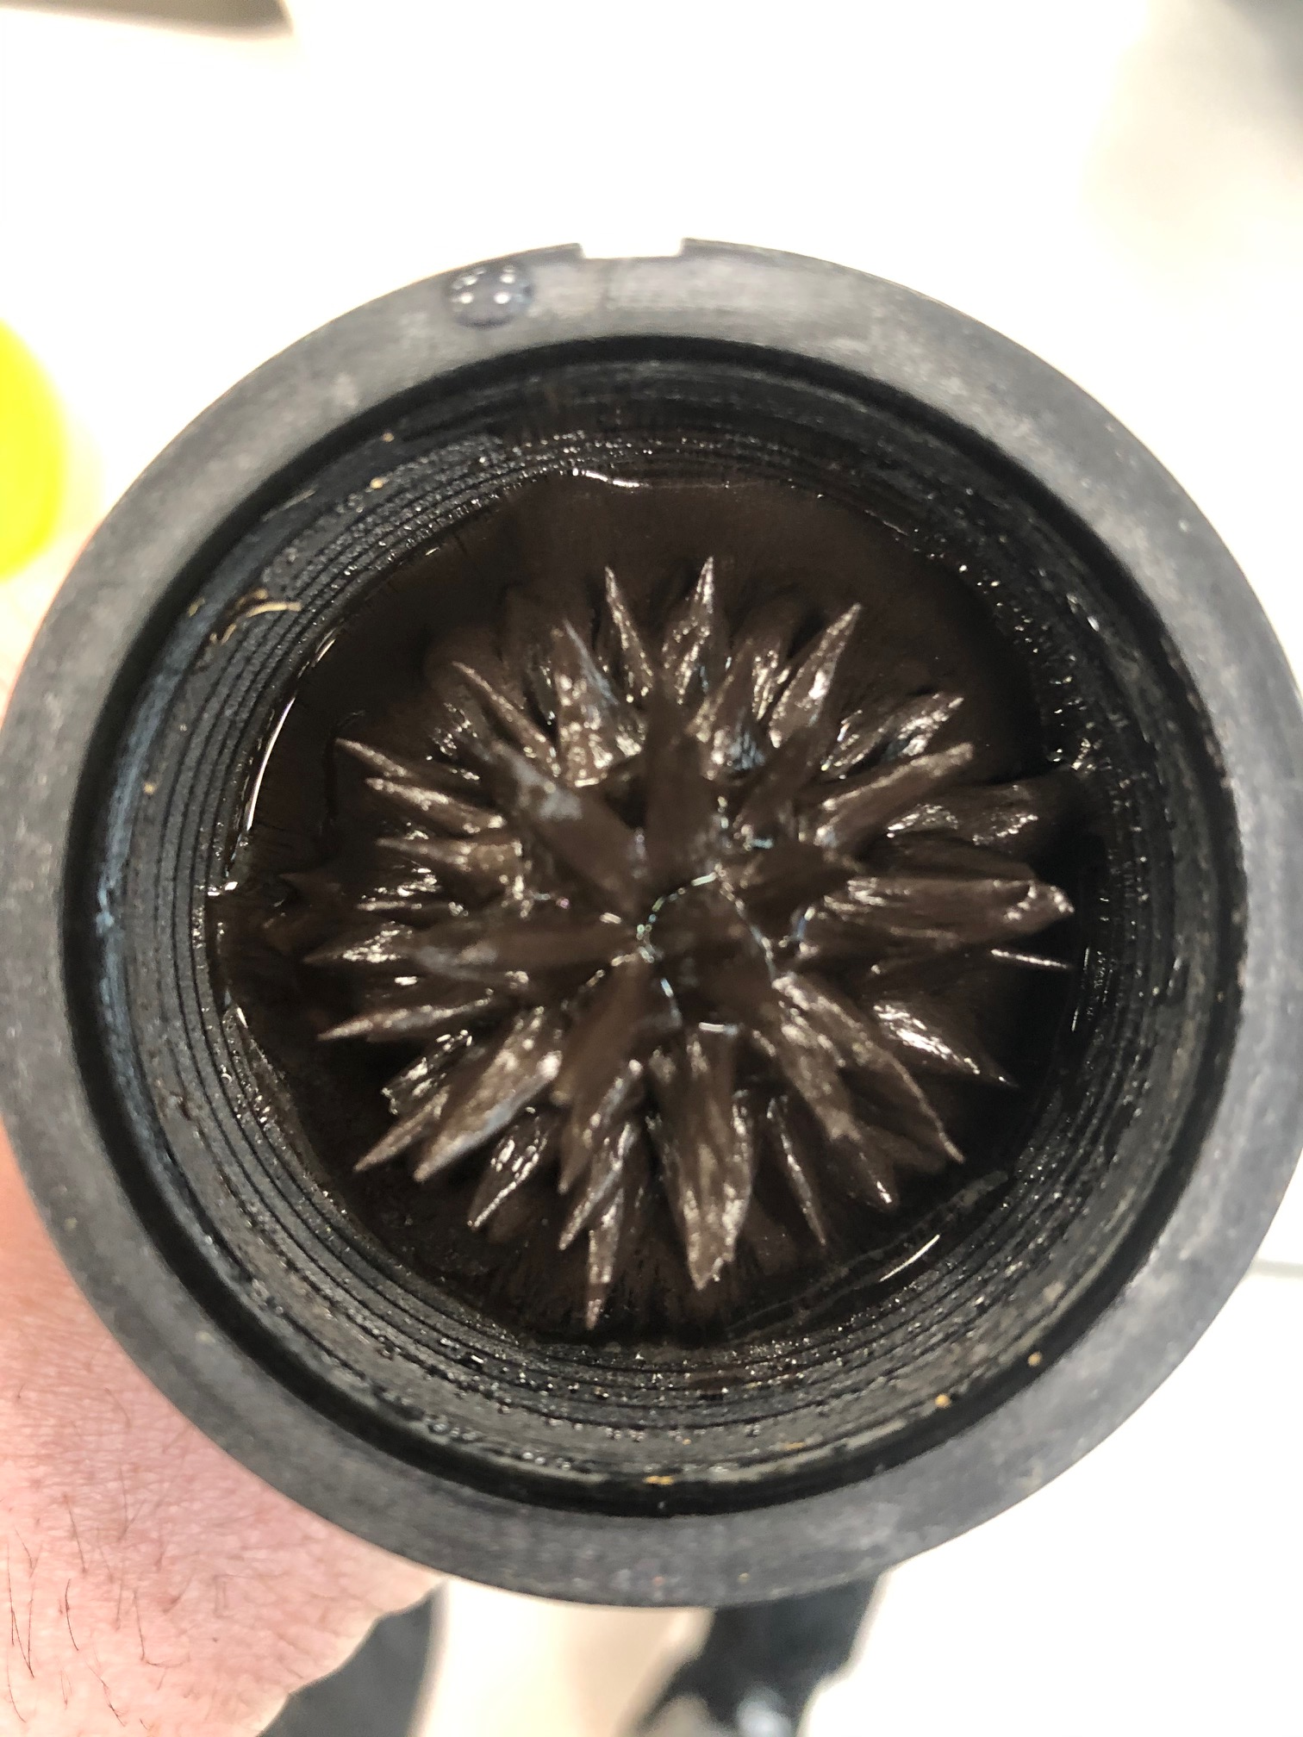
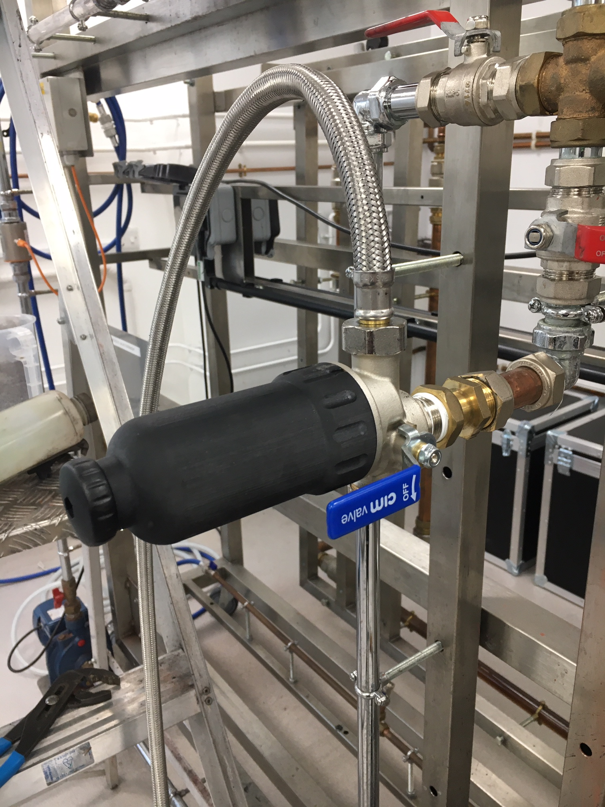
Collection CAPACITY
109.6 grams
Collection rig test setup
Company Confidential / Internal Use Only

Slide 5
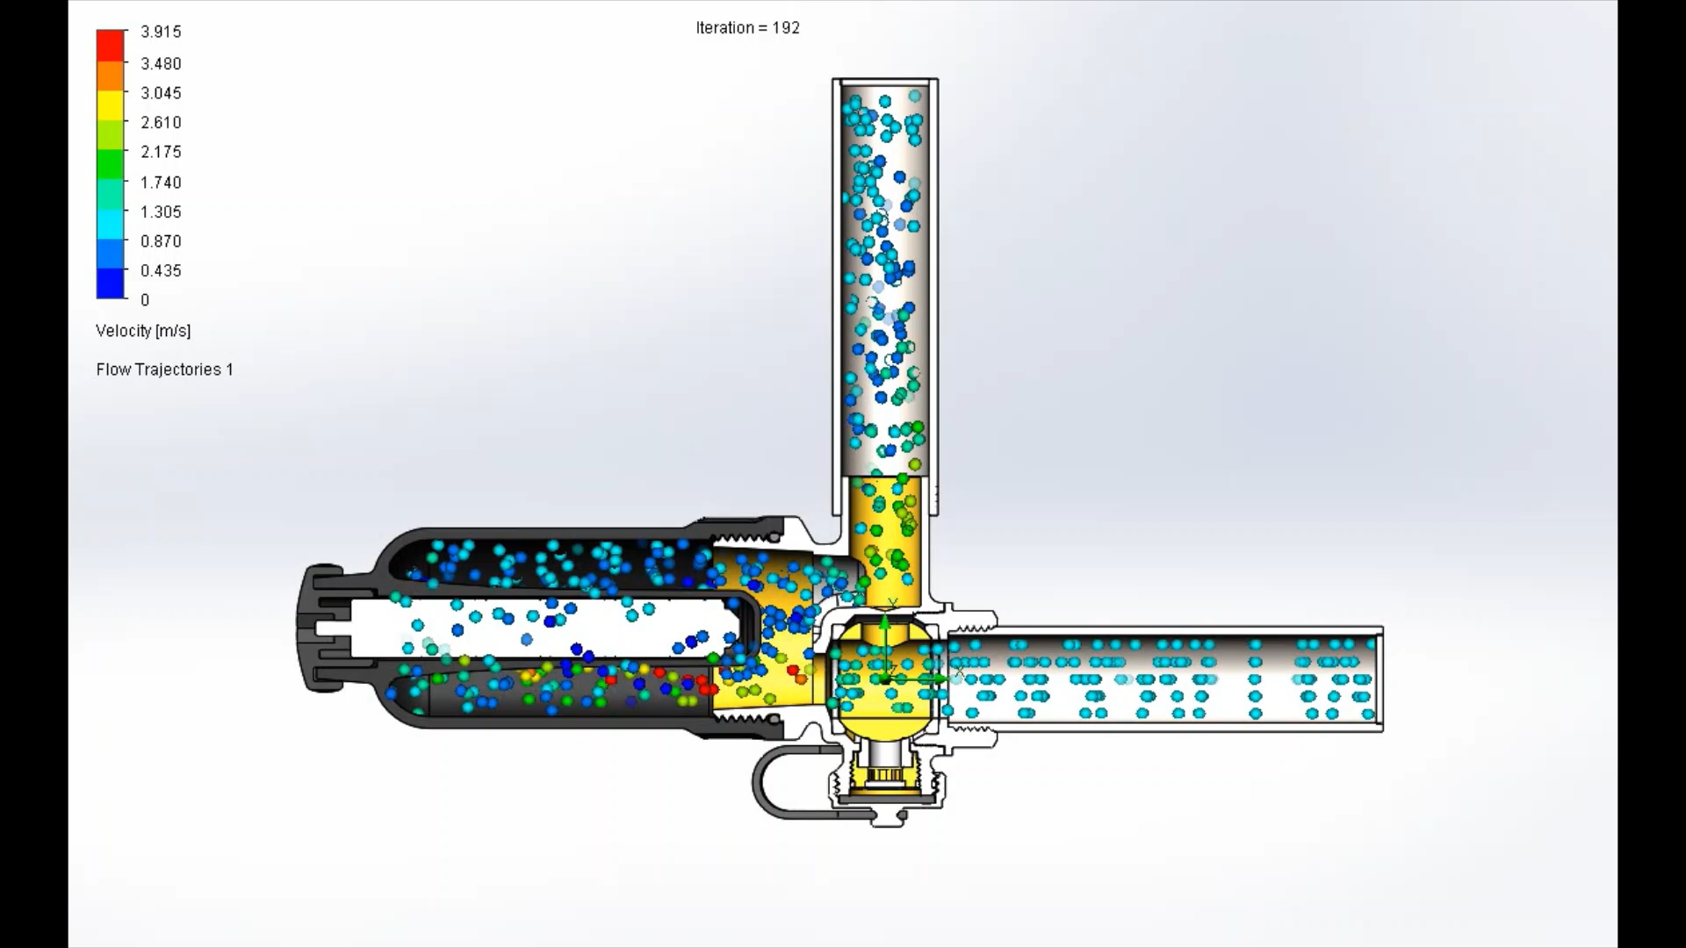
HYDROCYCLONIC
Flow path
Video
Low Velocity of water into the main body : sedimentation of the no ferrous particles.
Neodymium Magnet collects the ferrous particles.

Slide 6
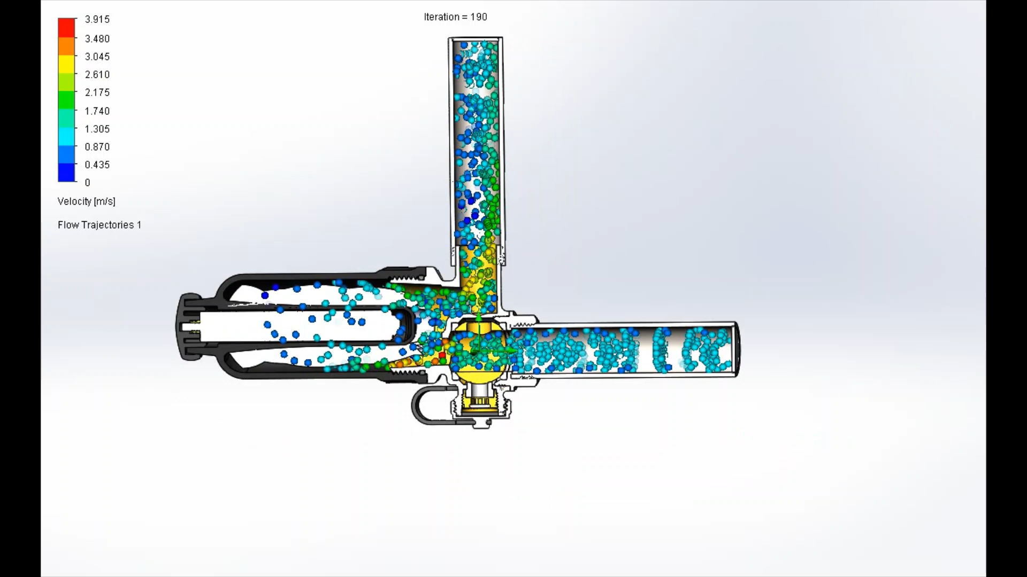
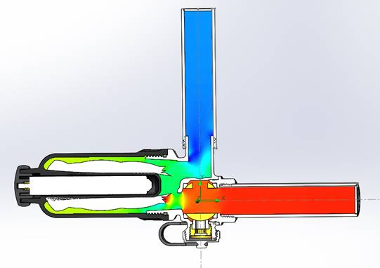
No Flow REDUCTION AT MAXIMUM COLLECTION CAPACITY
Video
Filter body full of dirt

Slide 7
Any question?
Giorgio Anselmo
Thanks for attention

